Slide 1
Crime in Los Angeles: Data Story Telling Using Visualizations
Aster Harris
Belay Kondidie
Liat Sayfan
Michelle Owino

Slide 2
Agenda
Overview
Getting Started
Challenges
Usage
Findings

Slide 3
Overview
Tracking crime data is important because it can help criminal justice professionals, policy makers and members of the community anticipate and prevent predicted crimes from occurring.
We’ve developed a tool that allows users to easily explore crime data based on crime types, years, months, location and victim demographics.
Crime is a significant concern for many people living in Los Angeles. Our goal is to examine the latest crime statistics for the city to gain a better understanding of the current state of crime in the area.

Slide 4
Overview
This interactive dashboard has:
User-friendly interface that makes it easy for users to navigate and interact with the data.
Charts to show frequency of crimes amongst various demographics.
Map of Los Angeles City crime rate by location.
Allows the user to select the year and the type of crime

Slide 5
Overview
Data is from data.gov
A government website that provides access to a wide range of public datasets.
The dataset reflects incidents of crime in the City of Los Angeles from 2010 to present.
We selected only 2018 to 2022.
The data was transcribed from original crime reports that are typed on paper.
Data includes information about the number and types of crimes.

Slide 6
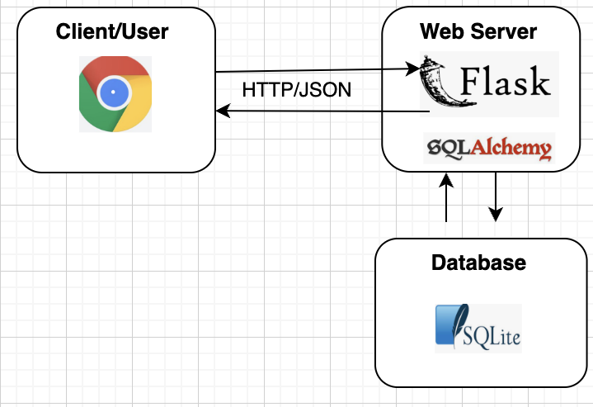
Getting Started: Data Flow
The CSV file is extracted using a Python script, cleaned using python pandas and loaded into a SQLite database
Data queries are done using SQLAlchemy.
Flask is then used to create API endpoints that can be accessed using HTTP requests.
The retrieved json data is then displayed using HTML and CSS in a web browser.
Java script is used to send requests to the Flask app and generate charts.

Slide 7
Getting Started: The Steps
Add visualizations to the page using JavaScript (D3, leaflet, Plotly, jQuery)
Prepare Data
data.gov - CSV
Create Database and Analyze Data
Visual Schema
Local Server Deployment
Create API server using Flask
Create Charts
Create Visualization Website
Python Pandas
SQLite database
Use HTML, CSS,
SQLAlchemy
1
2
3
4
5

Slide 8


Challenges
The Problem
The Solution
Installed Git Large File Storage (LFS)
LFS replaces large files such as audio samples, videos, datasets, and graphics with text pointers inside Git, while storing the file contents on a remote server like GitHub.com or GitHub Enterprise.
Installed Flask-Cors package
Import package into Flask app
Use cross-origin decorator on endpoint functions.
Dataset was large: We had over almost 750k records. Could not push to Github
Cross-Origin Resource Sharing (CORS) error when sending request to the local server
from flask_cors import CORS, cross_origin
app = Flask(__name__)
cors = CORS(app)
app.config['CORS_HEADERS'] = 'Content-Type'
@app.route("/")
@cross_origin()
def home():
Notes:
Cross-Origin Resource Sharing (CORS) is a standard that allows a server to relax the same-origin policy. This is used to explicitly allow some cross-origin requests while rejecting others. For example, if a site offers an embeddable service, it may be necessary to relax certain restrictions. Setting up such a CORS configuration isn't necessarily easy and may present some challenges. In these pages, we'll look into some common CORS error messages and how to resolve them.
If the CORS configuration isn't setup correctly, the browser console will present an error like "Cross-Origin Request Blocked: The Same Origin Policy disallows reading the remote resource at $somesite" indicating that the request was blocked due to violating the CORS security rules. This might not necessarily be a set-up mistake, though. It's possible that the request is in fact intentionally being disallowed by the user's web application and remote external service. However, If the endpoint is meant to be available, some debugging is needed to succeed.

Slide 9
Usage
Demo of how to interact with webpage

Slide 10
Findings
When looking at child maltreatment girls are more affected at 59% compared to boys at 41%.
Domestic violence is more prevalent amongst females than males. In 2022, 77% of reported domestic violence cases were from females.
Overall crime dropped in 2020. This could be due to the lockdown. It picked up in late 2021 and 2022.

Slide 11
Findings
Theft, robbery, and burglary are the highest crimes in LA followed by assault.
Extortion and vehicle theft are the least crimes.
Most of the theft, burglary, and assault victims are males.
Hispanics are the largest numbers of victims in LA followed by whites.
The crime data shows Asians are less affect by crime in LA compared to other races

Slide 12
Conclusion
Crime data for Los Angeles shows that there is still much work to be done to reduce crime rates in the city.
To achieve this, the City can invest in community-based programs to address underlying social issues and promote greater collaboration between law enforcement agencies and the community.

Slide 13
Thank you
Aster Harris
Belay Kondidie
Liat Sayfan
Michelle Owino

Slide 14
Questions?

